Slide 1
DATABASE ENGINEERING
Conflict Serializability Problems
with Precedence Graph Diagrams
Conflicting Operations • Graph Construction • Cycle Detection • Equivalent Serial Order
Solved problems and practice questions for Unit V

Slide 2
Conflict Serializability: Quick Rule
2
Two operations conflict if they belong to different transactions, access the same data item, and at least one operation is WRITE.
Pair | Conflict? | Reason
R1(X), R2(X) | No | Read and Read
R1(X), W2(X) | Yes | Read and Write
W1(X), R2(X) | Yes | Write and Read
W1(X), W2(X) | Yes | Write and Write
R1(X), W2(Y) | No | Different data items
Same item + different transactions + at least one WRITE = Conflict

Slide 3
Precedence Graph: How to Solve
3
• Create one node for each transaction.
• Find all conflicting operation pairs in the schedule.
• If Ti has the earlier conflicting operation and Tj has the later one, draw Ti → Tj.
• If the graph has no directed cycle, the schedule is conflict serializable.
• If the graph has a directed cycle, the schedule is not conflict serializable.
• For an acyclic graph, a topological ordering gives an equivalent serial order.
Acyclic graph = Serializable
Cycle = Not Serializable

Slide 4
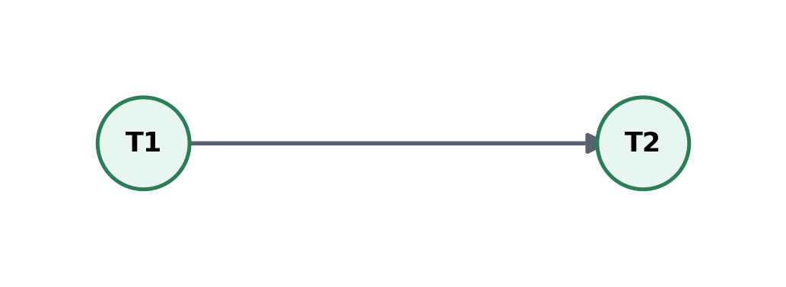
Solved Problem 1: Conflict Serializability
4
Schedule: R1(X), W1(X), R2(X), W2(X)
Step | Operation
1 | R1(X)
2 | W1(X)
3 | R2(X)
4 | W2(X)
Conflicting pairs and edges
• W1(X) before R2(X) ⇒ T1 → T2
• W1(X) before W2(X) ⇒ T1 → T2
No cycle. Conflict serializable.
Serial order: T1 → T2

Slide 5
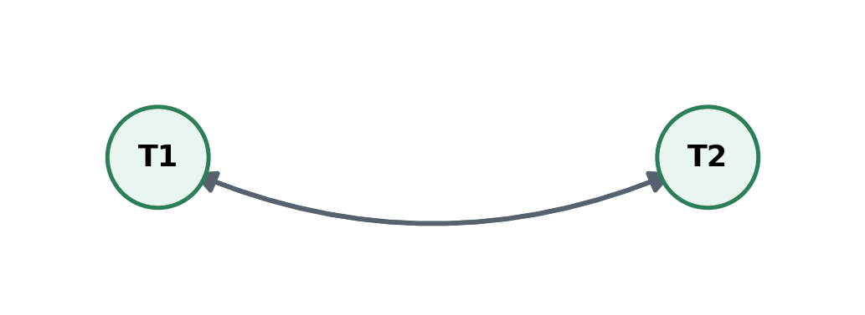
Solved Problem 2: Conflict Serializability
5
Schedule: R1(X), R2(Y), W1(Y), W2(X)
Step | Operation
1 | R1(X)
2 | R2(Y)
3 | W1(Y)
4 | W2(X)
Conflicting pairs and edges
• R1(X) before W2(X) ⇒ T1 → T2
• R2(Y) before W1(Y) ⇒ T2 → T1
Cycle exists. NOT conflict serializable.

Slide 6
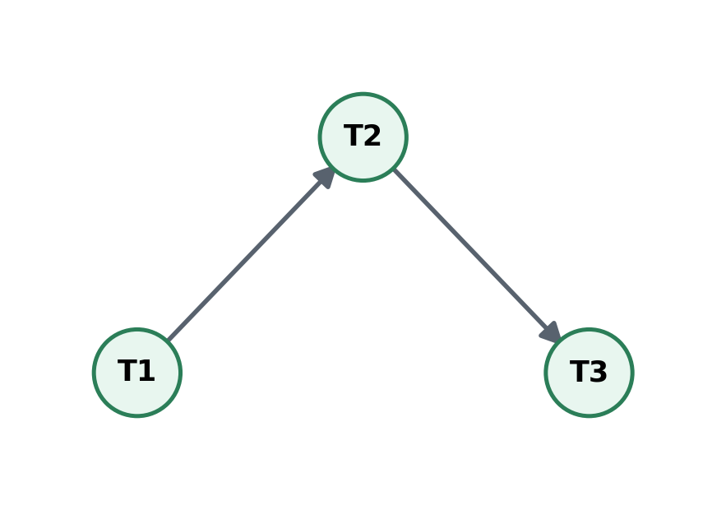
Solved Problem 3: Conflict Serializability
6
Schedule: R1(X), W1(X), R2(X), W2(Y), R3(Y), W3(Y)
Step | Operation
1 | R1(X)
2 | W1(X)
3 | R2(X)
4 | W2(Y)
5 | R3(Y)
6 | W3(Y)
Conflicting pairs and edges
• W1(X) before R2(X) ⇒ T1 → T2
• W2(Y) before R3(Y) ⇒ T2 → T3
• W2(Y) before W3(Y) ⇒ T2 → T3
No cycle. Conflict serializable.
Serial order: T1 → T2 → T3

Slide 7
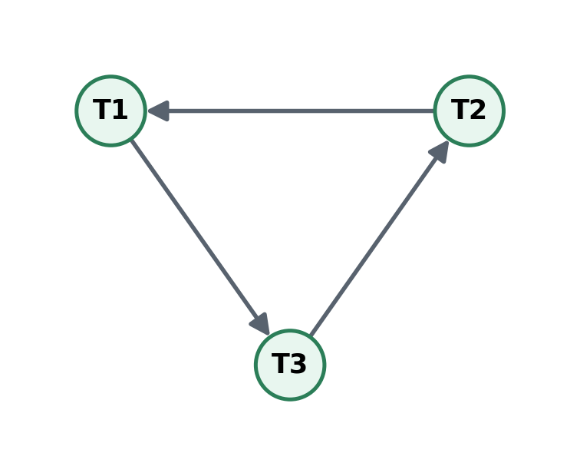
Solved Problem 4: Conflict Serializability
7
Schedule: R1(X), R2(Y), R3(Z), W1(Y), W2(Z), W3(X)
Step | Operation
1 | R1(X)
2 | R2(Y)
3 | R3(Z)
4 | W1(Y)
5 | W2(Z)
6 | W3(X)
Conflicting pairs and edges
• R2(Y) before W1(Y) ⇒ T2 → T1
• R3(Z) before W2(Z) ⇒ T3 → T2
• R1(X) before W3(X) ⇒ T1 → T3
Cycle exists. NOT conflict serializable.

Slide 8
Solved Problem 5: Conflict Serializability
8
Schedule: W1(X), R2(X), W1(Y), W2(Y), R2(Z)
Step | Operation
1 | W1(X)
2 | R2(X)
3 | W1(Y)
4 | W2(Y)
5 | R2(Z)
Conflicting pairs and edges
• W1(X) before R2(X) ⇒ T1 → T2
• W1(Y) before W2(Y) ⇒ T1 → T2
• Both conflicts create the same graph edge.
No cycle. Conflict serializable.
Serial order: T1 → T2
Multiple conflicts may produce only one directed graph edge.

Slide 9
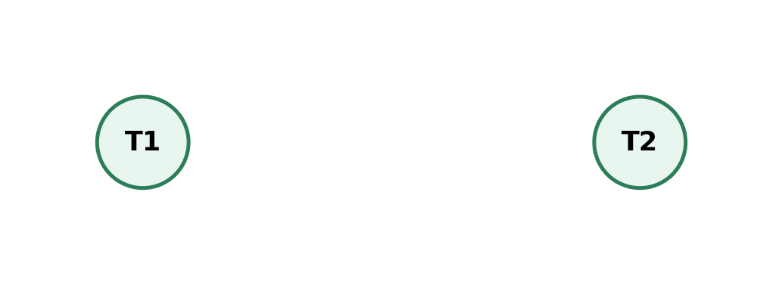
Solved Problem 6: Conflict Serializability
9
Schedule: R1(X), R2(Y), W1(X), W2(Y)
Step | Operation
1 | R1(X)
2 | R2(Y)
3 | W1(X)
4 | W2(Y)
Conflicting pairs and edges
• T1 accesses X only.
• T2 accesses Y only.
• There is no cross-transaction conflict.
No cycle. Conflict serializable.
Serial order: T1 → T2 or T2 → T1
A graph with no edges can have more than one serial order.

Slide 10
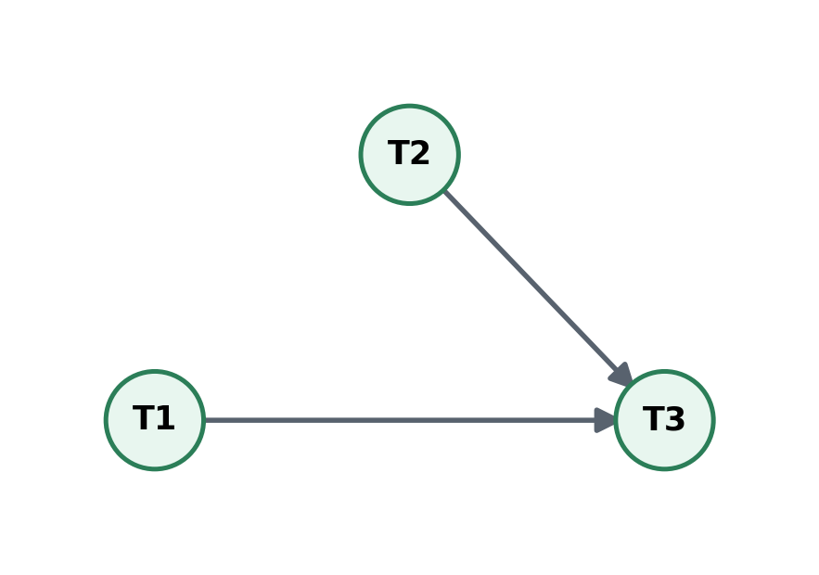
Solved Problem 7: Conflict Serializability
10
Schedule: R1(X), R2(Y), W1(X), W2(Y), R3(X), R3(Y)
Step | Operation
1 | R1(X)
2 | R2(Y)
3 | W1(X)
4 | W2(Y)
5 | R3(X)
6 | R3(Y)
Conflicting pairs and edges
• W1(X) before R3(X) ⇒ T1 → T3
• W2(Y) before R3(Y) ⇒ T2 → T3
• No conflict exists between T1 and T2.
No cycle. Conflict serializable.
Serial order: T1 → T2 → T3 or T2 → T1 → T3
The graph has two valid topological orders.

Slide 11
Solved Problem 8: Conflict Serializability
11
Schedule: R1(A), R2(B), W1(B), R3(C), W2(C), W3(A)
Step | Operation
1 | R1(A)
2 | R2(B)
3 | W1(B)
4 | R3(C)
5 | W2(C)
6 | W3(A)
Conflicting pairs and edges
• R2(B) before W1(B) ⇒ T2 → T1
• R3(C) before W2(C) ⇒ T3 → T2
• R1(A) before W3(A) ⇒ T1 → T3
Cycle exists. NOT conflict serializable.

Slide 12
Problem 9: Find Conflicts Step by Step
12
S = R1(A), W1(A), R2(A), R2(B), W2(B), R3(B), W3(C)
Data Item | Relevant Operations | Conflict Edge
A | R1(A), W1(A), R2(A) | T1 → T2
B | R2(B), W2(B), R3(B) | T2 → T3
C | W3(C) only | No cross-transaction edge
Acyclic graph
Serializable as T1 → T2 → T3

Slide 13
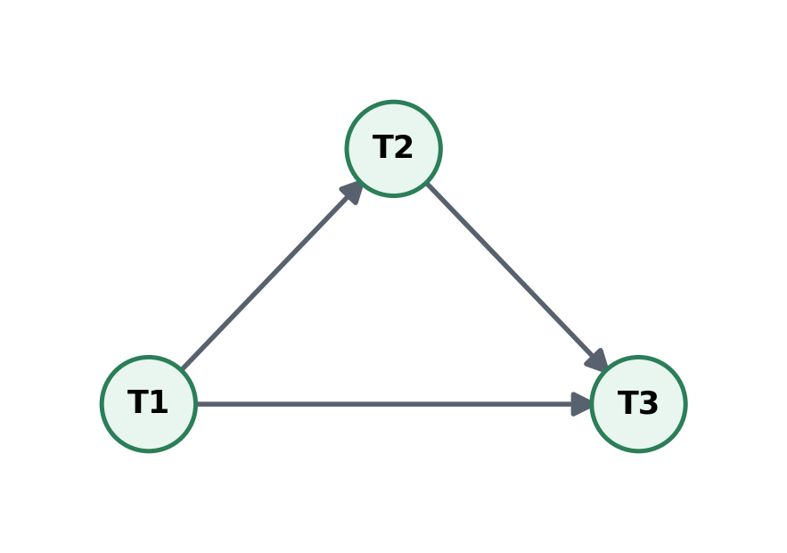
Problem 10: A More Detailed Acyclic Graph
13
S = R1(X), W1(X), R2(X), W2(Y), R3(Y), W3(X)
• On X: W1(X) before R2(X) gives T1 → T2.
• On X: W1(X) before W3(X) gives T1 → T3.
• On X: R2(X) before W3(X) gives T2 → T3.
• On Y: W2(Y) before R3(Y) gives T2 → T3.
• All edges move toward T3. There is no reverse path and no cycle.
Conflict serializable
Serial order: T1 → T2 → T3

Slide 14
From Precedence Graph to Serial Order
14
Edges: T1 → T3 and T2 → T3
• T1 must occur before T3.
• T2 must occur before T3.
• There is no ordering restriction between T1 and T2.
• Therefore two serial orders are possible.
T1 → T2 → T3
T2 → T1 → T3

Slide 15
Common Mistakes in Conflict Serializability
15
• Treating R1(X) and R2(X) as a conflict. Two reads do not conflict.
• Creating an edge for operations on different data items.
• Ignoring Write-Write conflicts.
• Drawing the edge in the wrong direction. Earlier conflicting operation points to the later transaction.
• Looking only at one conflict and missing a reverse edge that creates a cycle.
• Assuming an acyclic graph has only one serial order. Multiple topological orders may exist.

Slide 16
Practice Problems: Draw the Precedence Graph
16
• 1. S1 = R1(A), W1(A), R2(A), W2(A)
• 2. S2 = R1(A), R2(B), W1(B), W2(A)
• 3. S3 = W1(X), R2(X), W2(Y), R3(Y), W3(Z)
• 4. S4 = R1(X), R2(X), W1(Y), W2(Z)
• 5. S5 = R1(A), W1(B), R2(B), W2(C), R3(C), W3(A)
For each schedule: identify conflicts, draw edges, check for a cycle, and write the equivalent serial order if one exists.

Slide 17
Practice Problems: Answer Hints
17
Problem | Main Edges | Result
S1 | T1 → T2 | Serializable: T1 → T2
S2 | T2 → T1 and T1 → T2 | Cycle, not conflict serializable
S3 | T1 → T2 → T3 | Serializable: T1 → T2 → T3
S4 | No cross-transaction conflict | Serializable in either order
S5 | T2 → T1, T3 → T2, T1 → T3 | Cycle, not conflict serializable
Always verify every edge directly from the schedule before concluding.

Slide 18
Exam Strategy for a 5-Mark Problem
18
1
Write the schedule clearly
2
List conflict pairs item by item
3
Draw the precedence graph
4
Check whether a directed cycle exists
5
State serializable or not and give serial order if possible
Final answer format: Graph acyclic ⇒ conflict serializable ⇒ equivalent serial order = ...

Slide 19
Conflict Serializability: Final Recap
19
• Conflict requires the same data item, different transactions and at least one write.
• Use one node for each transaction in the precedence graph.
• For each conflict, draw an edge from the earlier transaction to the later transaction.
• A directed cycle means the schedule is not conflict serializable.
• An acyclic graph means the schedule is conflict serializable.
• A topological order of an acyclic graph gives an equivalent serial order.
Conflict pairs → Precedence graph → Cycle check → Serial order

